Slide 1
KTP Coding
Workshop
Coding in Python: Basics

Slide 2
Schedule
01
02
03
05
04
06
Basic Syntax
Overview
Jupyter Notebooks
Basic Functions
Basics of Loops
Basics of Control Flow

Slide 3

01
Overview

Slide 4
Why is Python useful?
Easy to Learn
Syntax resembles natural language - easy to pick up and identify errors
Many libraries to do many different things with
Data visualization, machine learning, web development and more
Large community of users
Lots of resources to aid in learning and solution assistance
Can handle large datasets

Slide 5
02
Jupyter Notebooks

Slide 6

So How Do You Use Python?
Jupyter Notebooks
Open-source web-based application
Google Colab
Free, cloud-based platform
You can run Python code in a Jupyter Notebook through Colab

Slide 7
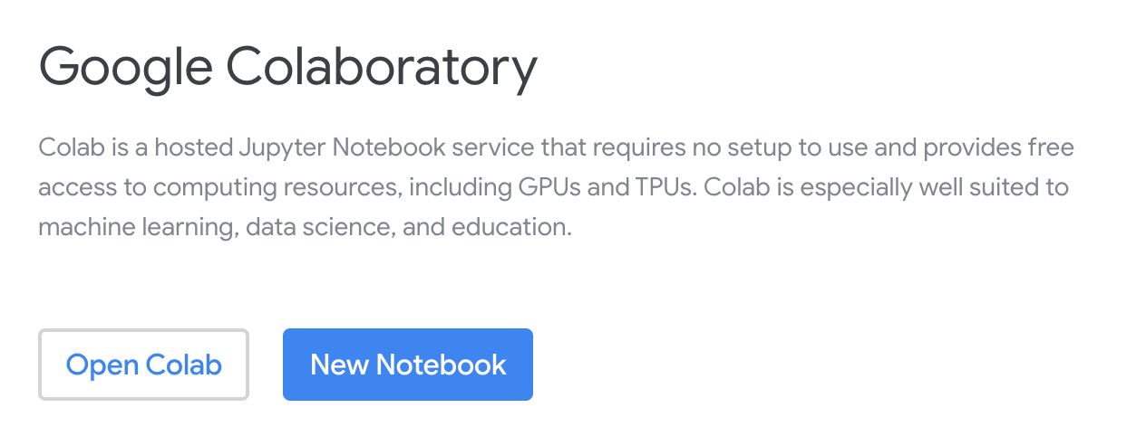
How to Open Google Colab

Slide 8
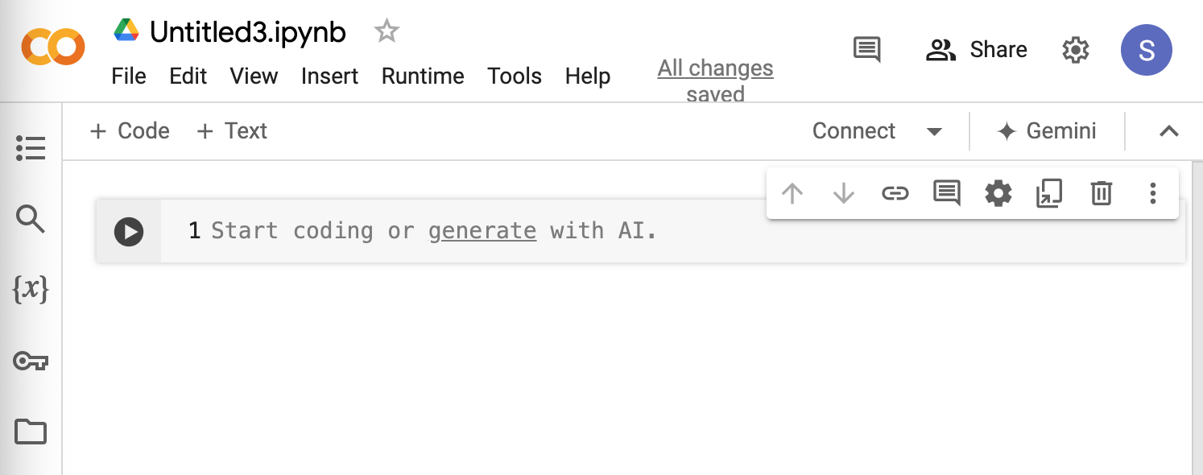
Should Look Like This Now

Slide 9
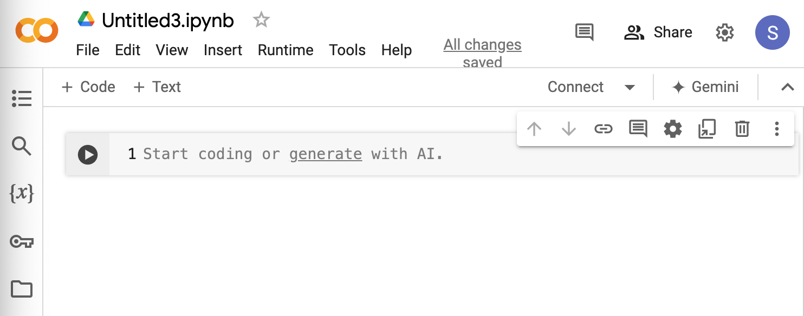
What Does Everything Mean?
This allows you to connect to a runtime - in other words it allows your code to process!

Slide 10
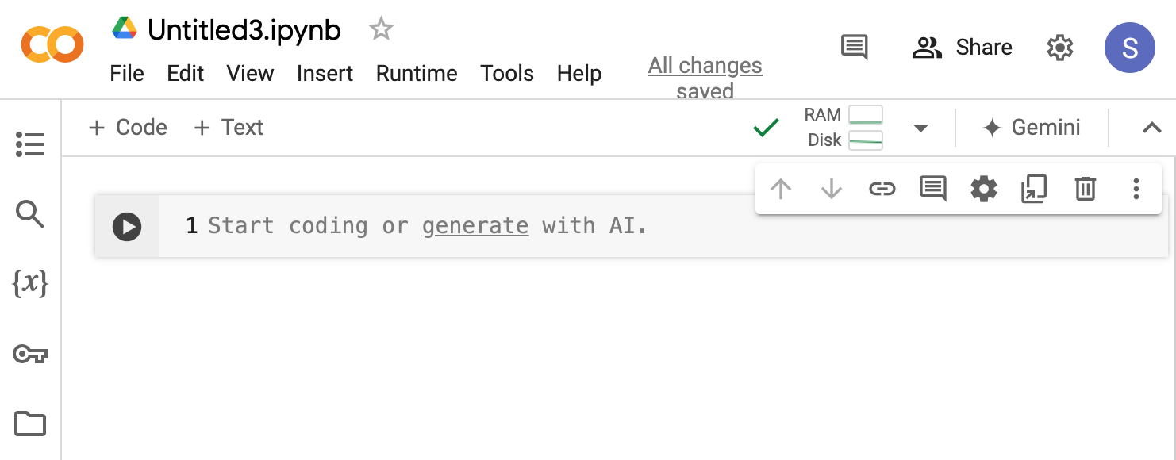
What Does Everything Mean?
If you click on connect, it will connect to a runtime and then display like this - now your code can run
Pressing this button will run the code cell

Slide 11
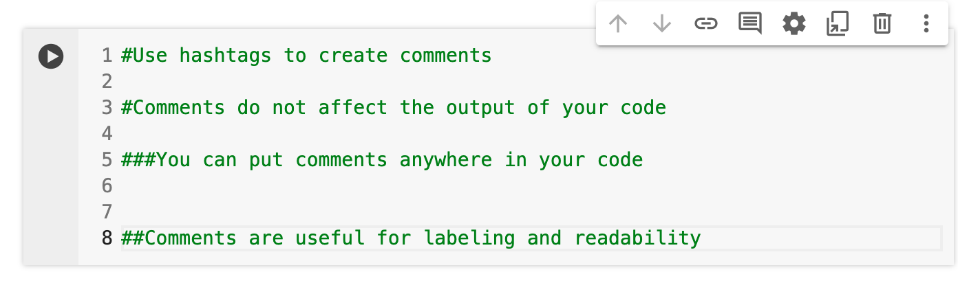
Creating Comments

Slide 12
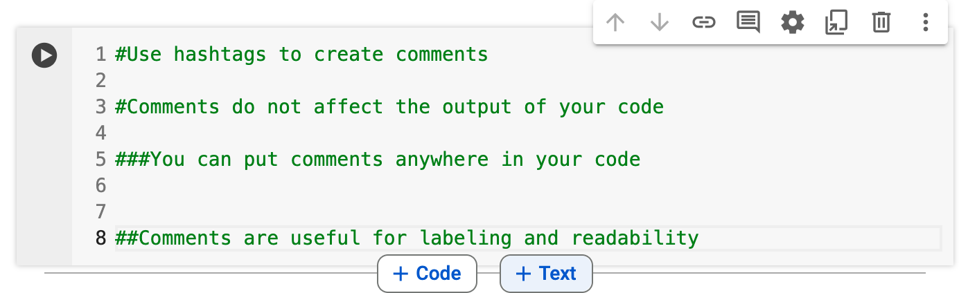
Headers and Text Boxes
To create a text cell
You can use Command MM (on a mac)
Hover near the top or bottom of your current cell and then click “Text”
Add Text Box

Slide 13
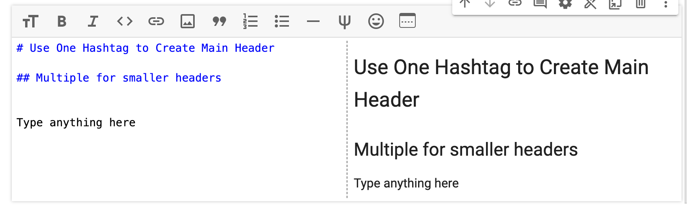
Headers and Text Boxes
This is your code
This is the output

Slide 14
03
Basic Syntax

Slide 15
Data Types
int (integer)
str (string)
Represents integer values (whole numbers)
3, -5, 0 are all integer values
Represents text (string)
Enclosed with quotes - single or double
“Hello”, ‘Python is Cool’, “3 is the best number”
float values
boolean
Represents a floating point number (decimal)
31.0, -0.987, 45.24
True or False value
Connected to comparison operators: <, >, !=, ==

Slide 16
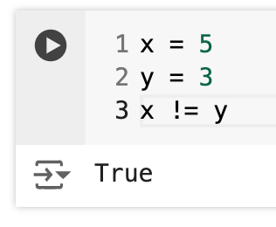
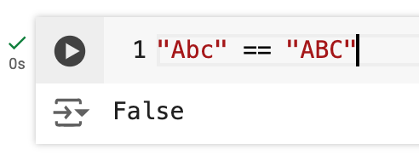
More on Boolean Values
Syntax
True
False
Comparison Operators
!= means does not equal
== means equal
You can compare string, integers and float values

Slide 17
Using ‘And’ and ‘Or’ To Compare
And
True and True = True
True and False = False
False and False = False
Or
True or True = True
True or False = True
False or False = False

Slide 18
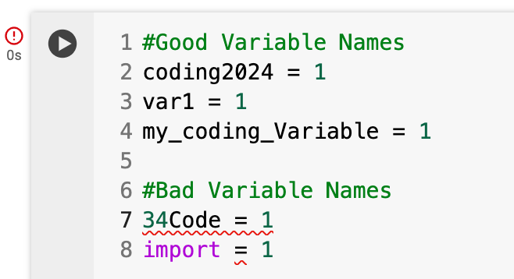
Naming Variables
Assign Variables using ‘=’
Ex:
thisVariable = 4
Do’s
Use letters and numbers
Use underscores
False or False = False
Recognize case sensitivity
Don’ts
Start with a number
Use Python keywords as a variable name

Slide 19
04
Basic Functions

Slide 20
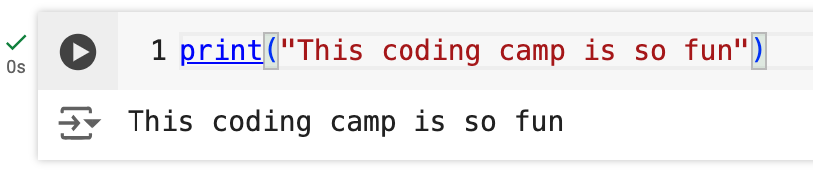
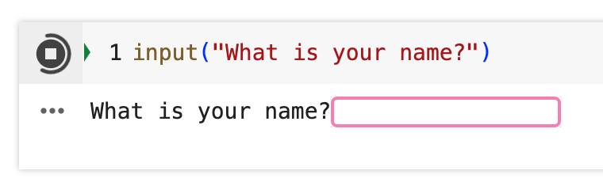
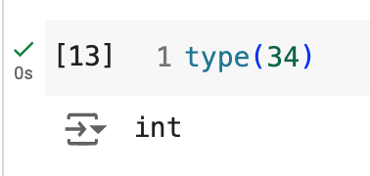
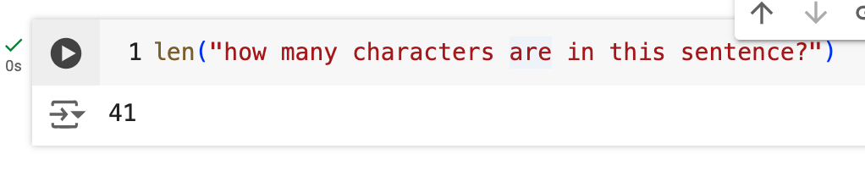
Basic Functions
print()
input()
Displays result to the screen
Allows user to enter input
len()
type()
Returns the length of an object
Returns the data type

Slide 21
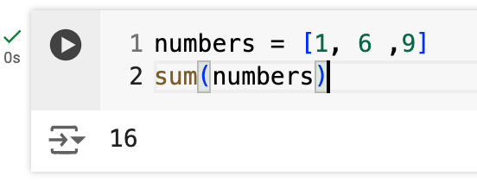
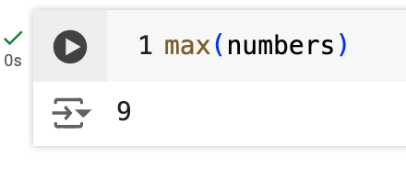
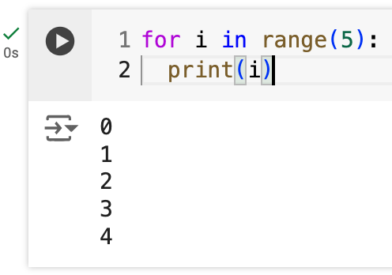
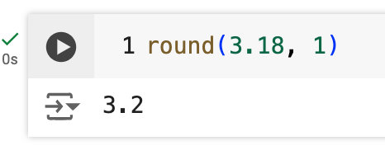
More Basic Functions
sum()
max() and min()
Returns the sum
Returns the max and min values
round()
range()
Rounds a float to specified number of decimals
Returns a sequence of numbers

Slide 22
05
Control Flow

Slide 23
Control Flow - If Statements
Tells python what to execute and in what order using conditional statements
If, else and elif
Elif means “else if”
Syntax is very important in control flow
Use of colons
Use of indentation

Slide 24
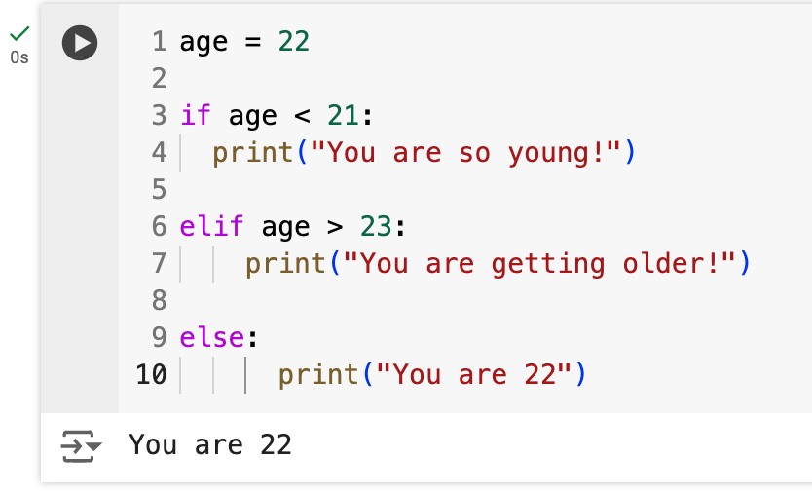
Control Flow - Conditional Statements
‘If’ checks a condition. If it is true, it will execute.
‘Elif’ checks additional conditions in the case that the if condition is not true
‘Else’ runs only if all other conditions are false

Slide 25
06
Loops

Slide 26
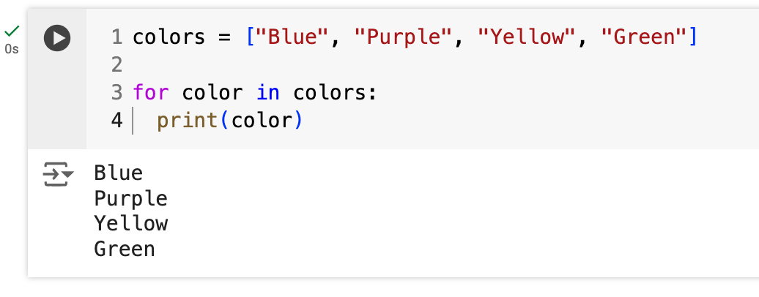
Control Flow - For Loops
For loops allow you to iterate over a sequence
Useful if you want to print out something multiple times
Brackets are used to create a list

Slide 27
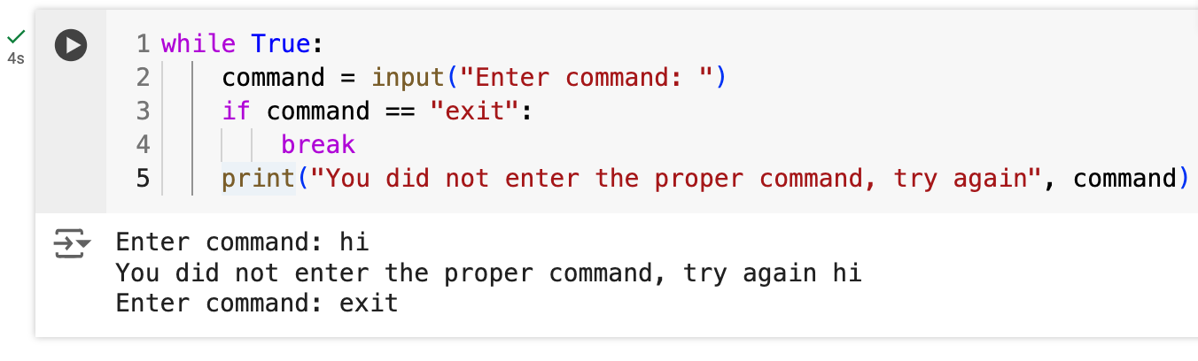
Control Flow - While Loops
While loops will continue running - so long as a condition is true
Useful if you are not sure how many times the loop will have to execute until you get the result you want

Slide 28
SO MUCH MORE TO LEARN!
Object oriented programming
Lists and Tuples
Dictionaries
Pandas
Importing Files
Data Visualization
…MORE!!!
Helpful Resources
W3 Schools
Kaggle
LinkedIn Learning
Generate AI on Google Colab
THANKS FOR LISTENING!!!

